Slide 1
An authorized user can make payments on your account by logging on with their own username and password.
Click on the Authorized Users tab to add an authorized user.

Slide 2
Enter the authorized user’s email address and click Yes or No for the authorized user to view your payment history. Then click Continue to proceed.

Slide 3
The Agreement to Add an Authorized User page will pop up. Check the box next to I Agree and click the Continue button. You may also Print your agreement by clicking the Print Agreement button

Slide 4
Authorized users can be edited or deleted at any time by clicking the Edit or Delete buttons You may add 5 authorized users to your account Each user will appear on your Authorized Users page

Slide 5
Your authorized user has been added. The authorized user will receive two emails. One email will have the link to Touchnet login and the other will have a temporary password.
k.viator@gmail.com

Slide 6
This is a copy of the email your authorized user will receive. Your authorized user may be an authorized user on another student’s account as well as yours.

Slide 7
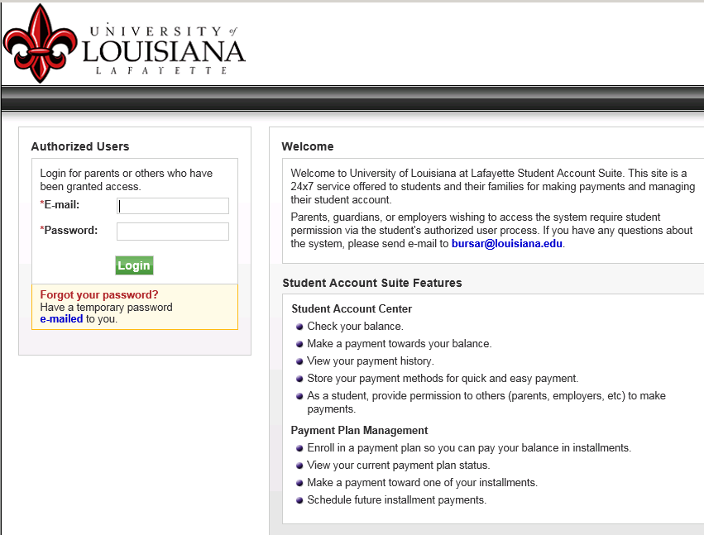
The authorized user must use this login to view their student’s account. Enter the authorized user’s email address and password sent by Touchnet. If the authorized user has forgotten their password, click the e-mailed link and a temporary one will be assigned to you.

Slide 8
An email will be sent to your authorized user with a temporary password, to return to the login page click Return to Login Page

Slide 9
The authorized user’s temporary password will appear in an email like this one, copy your temporary password into the Touchnet payment system

Slide 10
Enter email and password and click the Login button

Slide 11
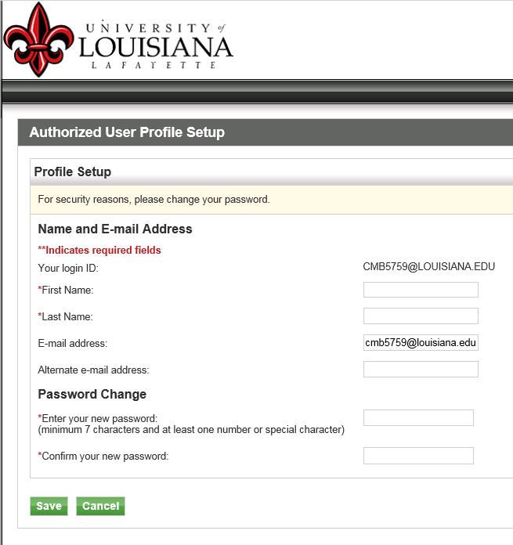
The authorized user’s profile must be setup Enter all information with an * next to it Change your password You can enter an alternate email address if you choose Click Save

Slide 12
If you are an authorized user for more than one student, they will all appear on your screen. You may make a payment to all of their records at once or one at a time. Double click the student’s name that you would like to pay.

Slide 13
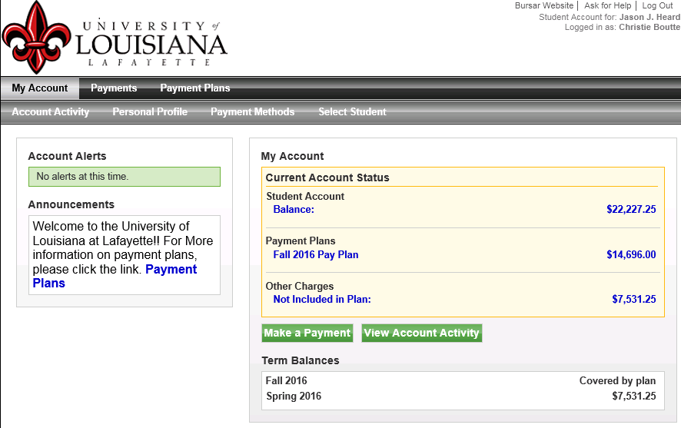
The authorized user can now view the account and make payments.
See How to Make a Payment and
View Student Activity slides for more details

Slide 14
THE END

