Slide 1
NEW STATEMENT OF ACCOUNTS

Slide 2
Our process has changed. You will need to activate your ULink account before you can see your account.

Slide 3
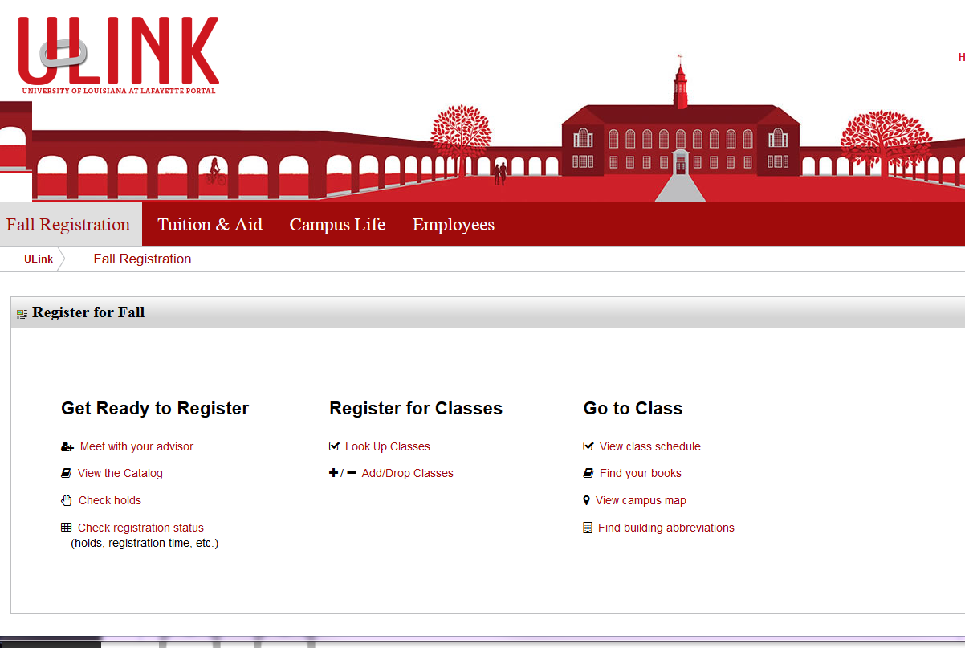
Go to the Tuition and Aid Tab

Slide 4
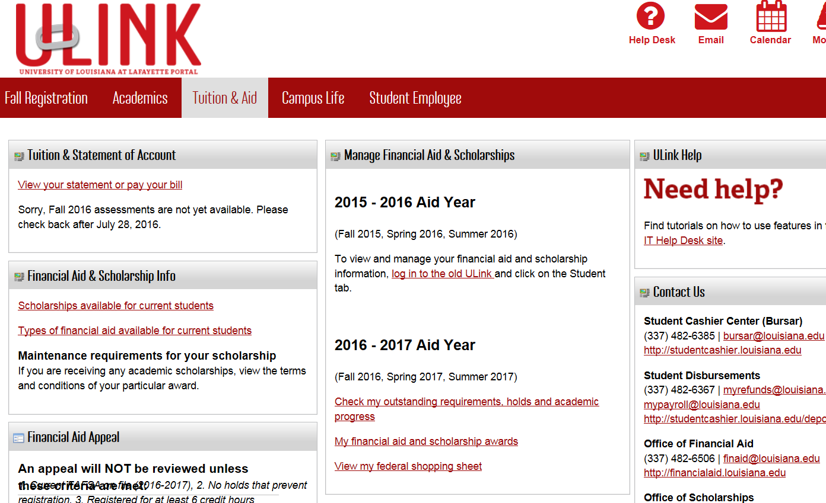
Go to the Tuition & Statement of Account tab.
Click on View your statement or pay your bill

Slide 5
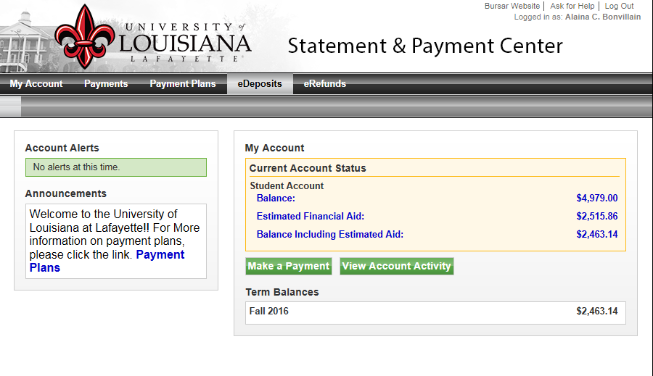
Welcome to the Statement and Payment Center Click on the eDeposits tab

Slide 6
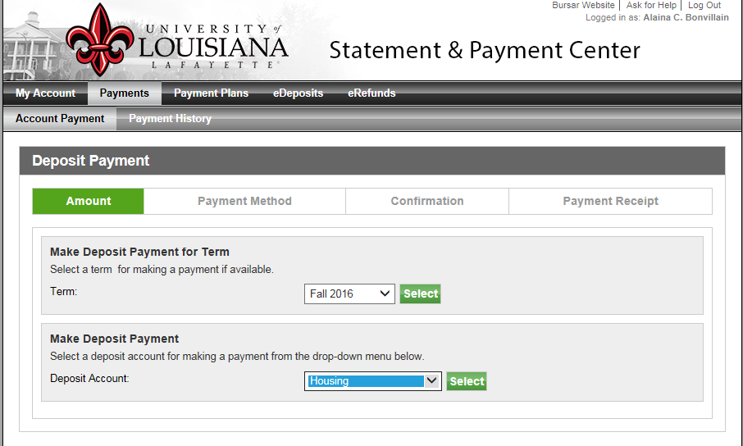
In the Make a Deposit Payment for Term section, click the arrow and selection the term you would like to make a deposit for, then click the Select button. In the Make a Deposit Payment section, click the arrow and select housing, then click the Select button

Slide 7
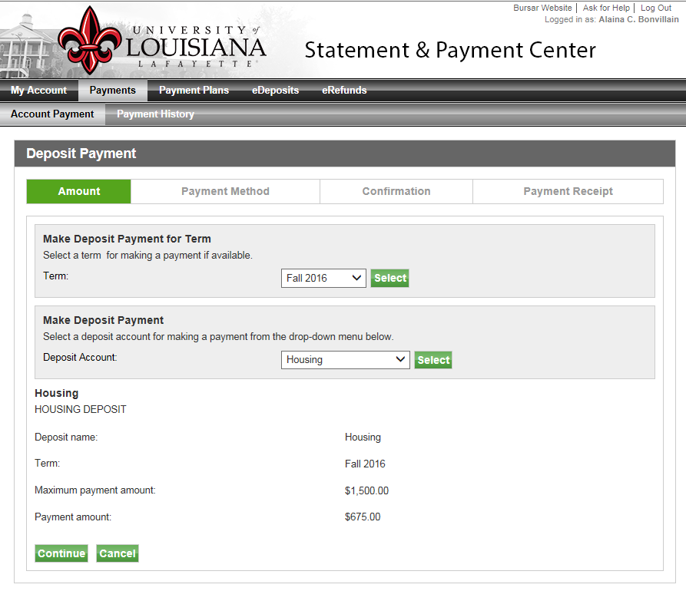
The amount of the deposit will appear, I’m not sure what the maximum amount does, because it would not allow me to change the deposit amount

Slide 8
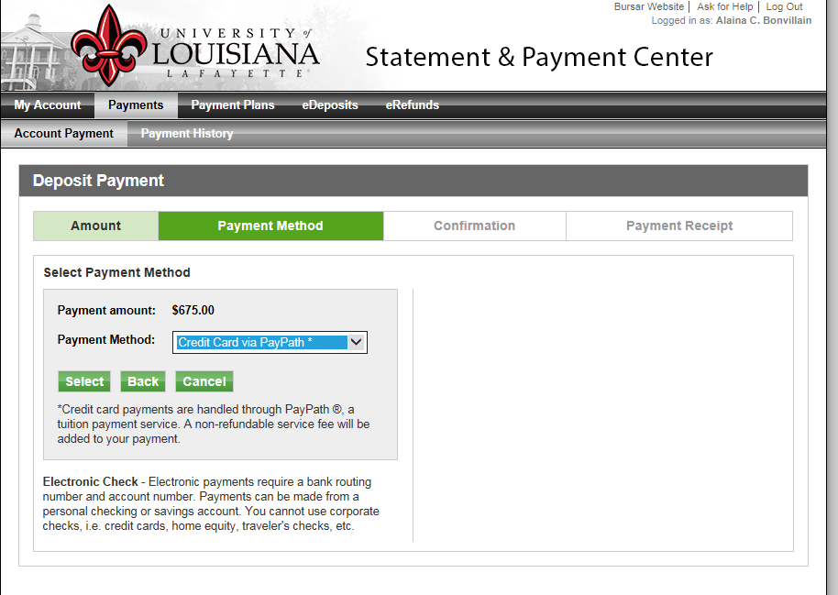
Select the payment method by click the arrow button next to Payment Method and clicking the Select button

Slide 9
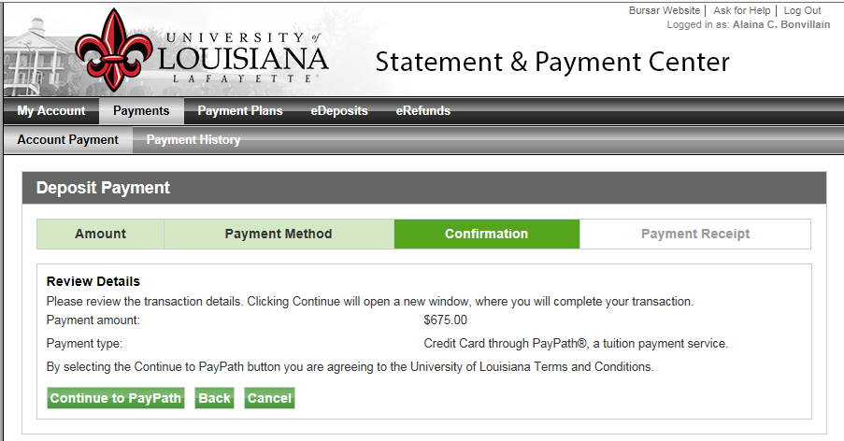
This page is confirmation that you are ready to make a payment

Slide 10
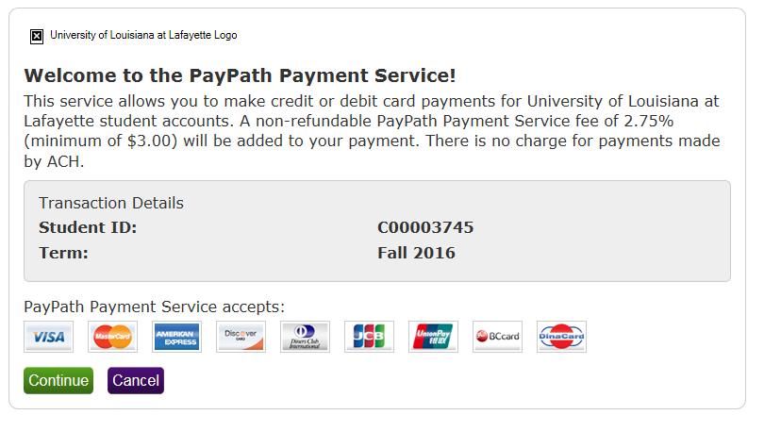
By choosing to pay with a credit card, an additional 2.75% (minimum of $3) will be added to your payment. Click the Continue button if you are ready to make your payment

Slide 11
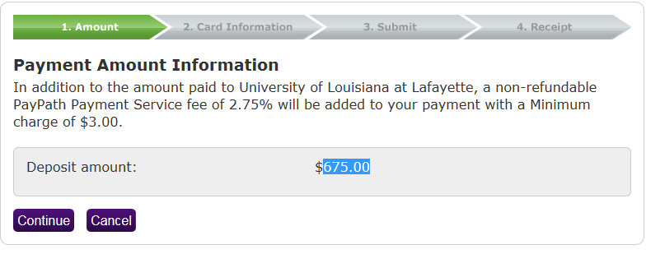
A second confirmation page will come up, if you would still wish to pay with a credit card, click Continue.

Slide 12
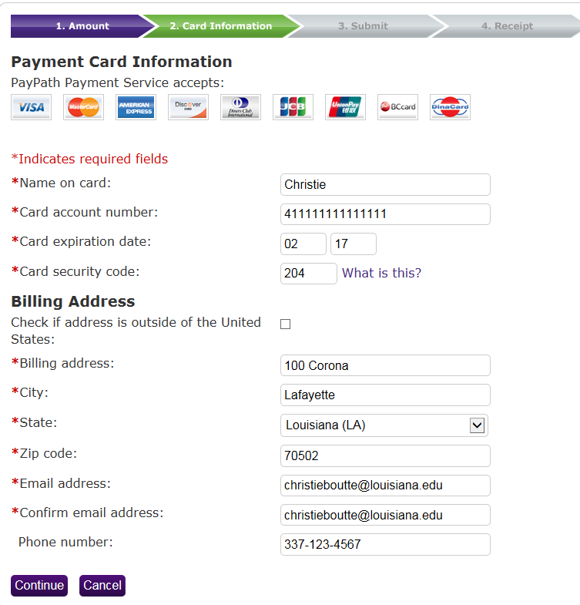
Enter credit card information and click Continue

Slide 13
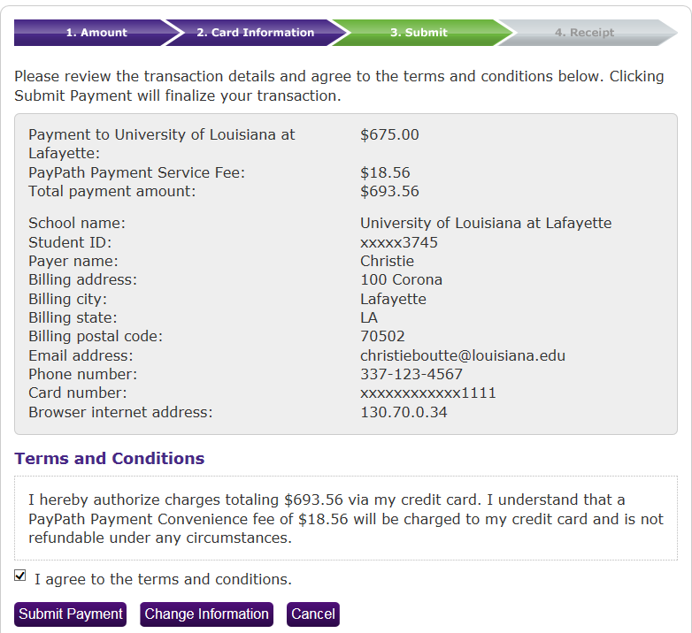
Check the box to agree to the Terms and Conditions and click Submit Payment

Slide 14
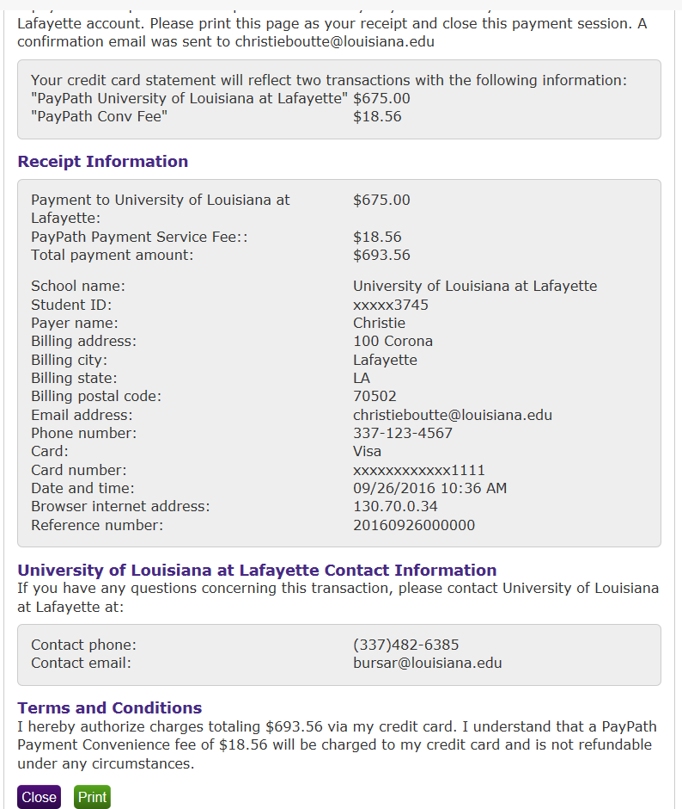
Your receipt will appear, if you would like to print your receipt, click the Print button, if not click Close.

Slide 15
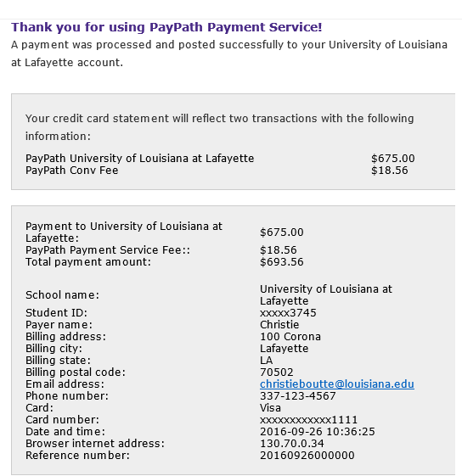
You will receive a confirmation email that looks like this

Slide 16
Auto release must have a Y and the release date must be changed each semester.

Slide 17
THE END

